Slide 1
Mantid Users Workshop
Travel meeting

Slide 2
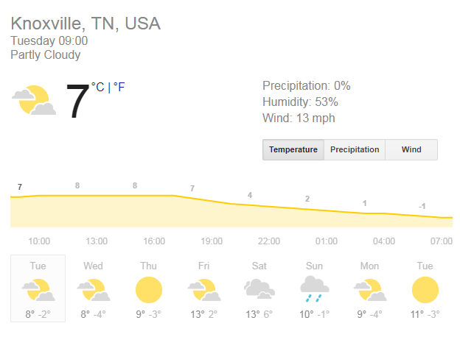
Weather

Slide 3
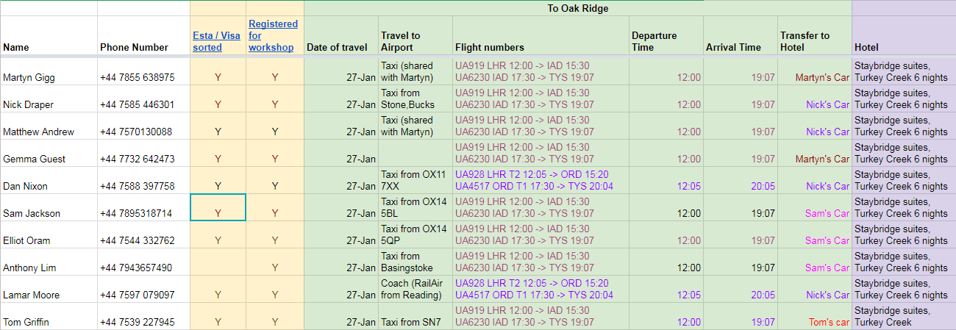
Travel arrangements
https://tinyurl.com/mantid18

Slide 4
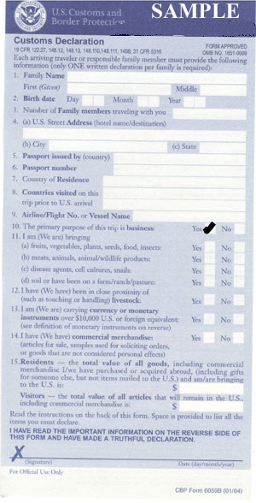
Immigration
On the customs form AND at the immigration booth state the purpose of your visit as business
Otherwise you will not be allowed on site at ORNL

Slide 5
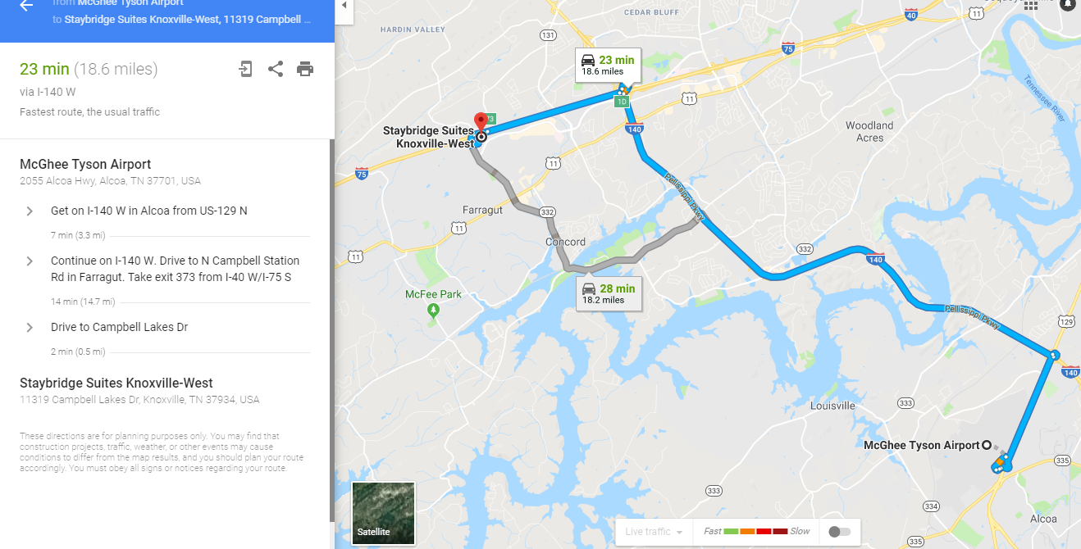
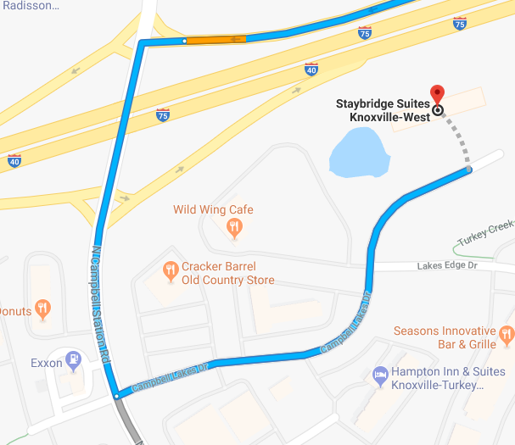
Route to the Hotel

Slide 6
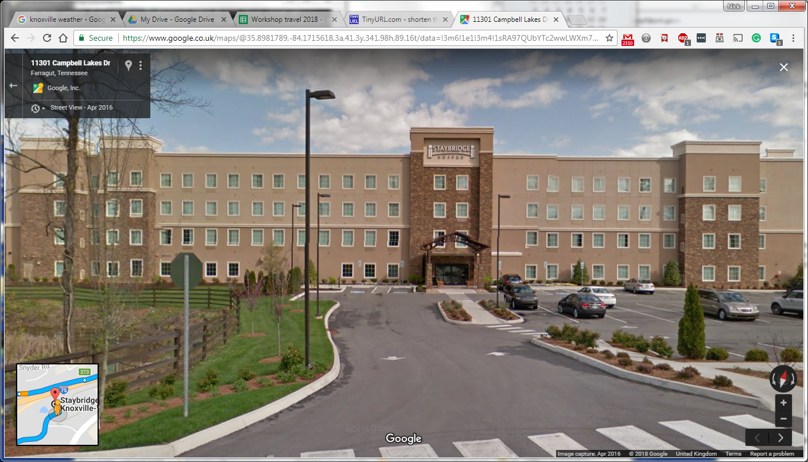
The Hotel seen from the road
11319 Campbell Lakes Dr, Knoxville, TN 37934, USA +1 865-675-7829

Slide 7
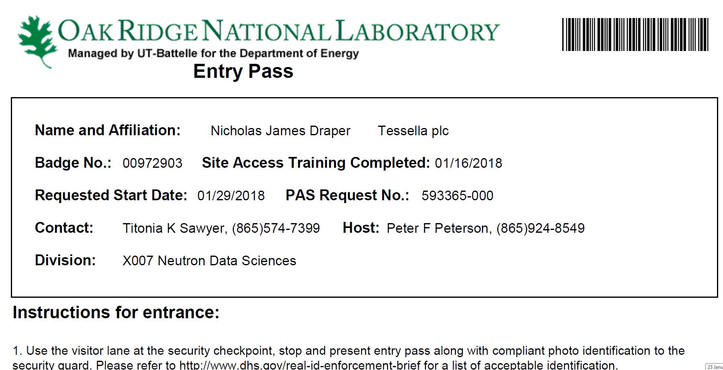
Entry Pass
You should get a pass emailed to you, print it out and take it along.

Slide 8
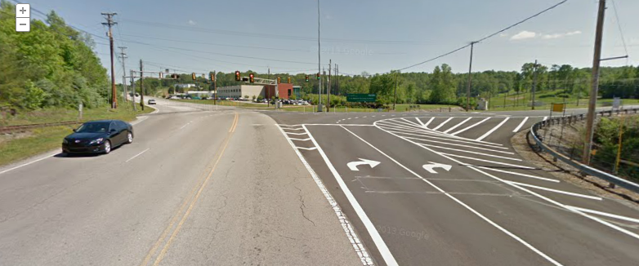
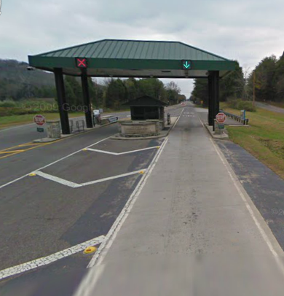
Getting into ORNL
8:30am Meet in Hotel Lobby (With Passports & entry pass) Split into cars and drive to ORNL Do NOT drive into Y-12
9:00 Use the right lane at the gatehouse
Then drive to visitor centre to collect passes Then drive to the SNS

Slide 9
Meeting attendees and agenda
https://www.mantidproject.org/Category:Users_Workshop_2018

Slide 10
Other information
Meeting Host: Garrett Granroth 865-805-0631
Nick’s Phone number: +44 7585 446301

Slide 11

Any Questions

